Slide 1

PYTHON PTOJECT
BY TEAM - RUSHI LAXMAN MANIKUMARREDDY

Slide 2

Introduction to Dataset
We have used Flight dataset
This dataset comprises a comprehensive collection of over 200,000 records, encompassing various facets of flight information.
It includes crucial details such as airline specifics, flight codes, departure and arrival times, flight durations, number of stops, and corresponding prices. This dataset is instrumental in unraveling essential insights into the complex landscape of flight pricing dynamics and operational patterns within the aviation industry

Slide 3
EDA METHODOLOGY (exploratory Data Analysis approach)
Data Conversion:
Converted 'price' to numerical format for analysis by removing commas and converting to float.
Transformed 'date' column to datetime format for temporal analysis.
Visualizing Data Distributions:
Utilized Matplotlib and Seaborn libraries for insightful visualizations.
Demonstrated the distribution of 'num_code' (flight number) through a histogram plot with a KDE.
Explored the distribution of airlines within the dataset using a count plot.

Slide 4
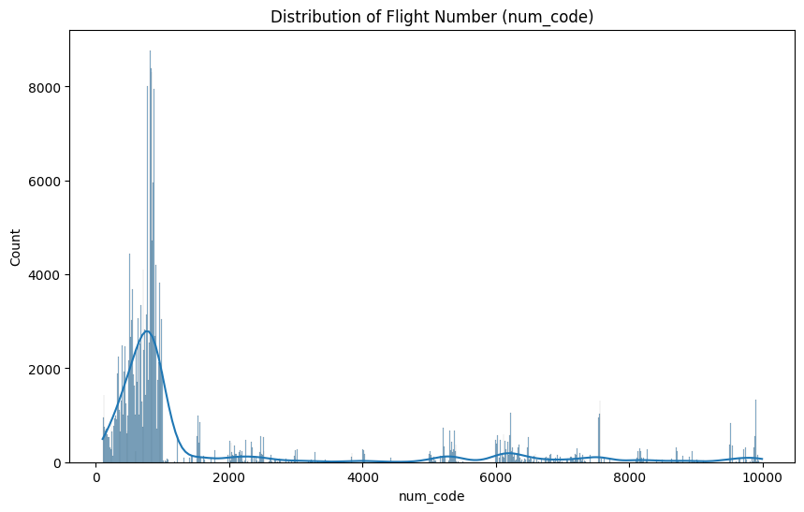
Distribution of Flight Number
Graph Description:
Illustrates flight number distribution based on frequency within the dataset.
Possibly employs a kernel density estimate for visualizing the distribution pattern.
Key Observations:
Concentration of flight numbers primarily in the lower numerical range.
Presence of multiple peaks suggests certain groups of more common flight numbers.
Sparse occurrences of higher flight numbers indicate less frequent routes.
Wide spread of flight numbers hints at diverse operations across airlines or destinations.
Outliers or spikes at intervals imply potential seasonal or charter operations.

Slide 5
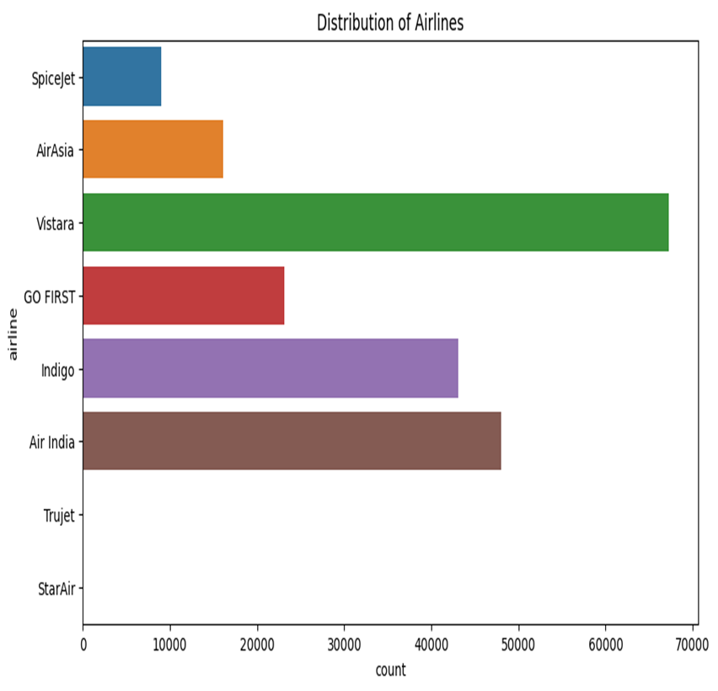
Airlines' Flight Operations
Bar Chart Visualization
Illustrates flight counts for various airlines.
'X-axis' represents flight counts; 'Y-axis' lists the airlines.
Key Observations:
Vistara leads in flight operations, followed by Air India.
Indigo maintains a moderate presence among airlines.
SpiceJet, GO FIRST, Trujet, and StarAir have notably fewer operations.
Disparity in operation sizes is stark, with Vistara having significantly more flights than smaller airlines.
Clear dominance of a few airlines hints at potential market concentration.
This bar chart offers insights into the varying degrees of flight operations among different airlines, showcasing potential market dominance and disparities in operational scale.

Slide 6
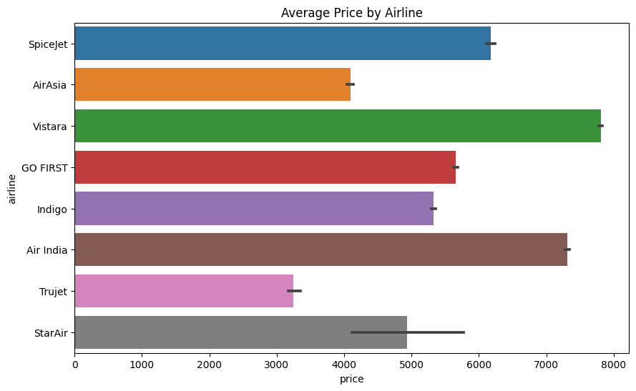
Average Ticket Prices by Airline
Bar Chart Overview:
Displays average ticket prices for various airlines.
'X-axis' represents average price, 'Y-axis' lists airlines.
Key Insights:
StarAir: Highest average ticket price among listed airlines.
Trujet: Positioned with the lowest average price, potentially a budget airline.
Price Range Variation: Indicates diverse market positioning from premium to budget options.
Vistara: Premium services reflected in a higher average price.
Indigo & GO FIRST: Mid-range prices suggest competitive pricing strategies.
This analysis highlights the diverse market positions of airlines based on their average ticket prices, from budget-focused to premium service offerings.

Slide 7
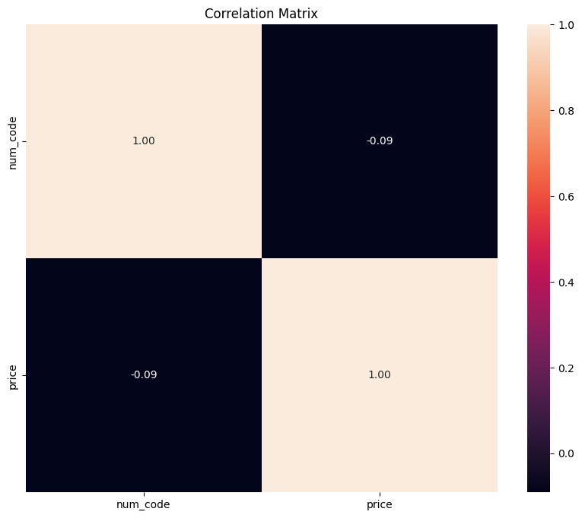
Correlation Analysis - Flight Number vs. Price
Matrix Description:
Visualizes Pearson correlation coefficients between numerical variables.
Analyzed variables: Flight number (num_code) and flight price.
Key Findings:
Weak Negative Correlation: Flight number and price exhibit a correlation coefficient of -0.09.
Limited Predictive Power: Indicates no strong linear relationship; flight number isn't a reliable price predictor.
Near-Zero Correlation: The coefficient close to 0 suggests almost no correlation.
Self-Correlations: Diagonal values at 1.00 indicate perfect correlations with themselves.
The analysis reveals a weak negative correlation between flight number and price, implying minimal predictive value of flight number on pricing.

Slide 8
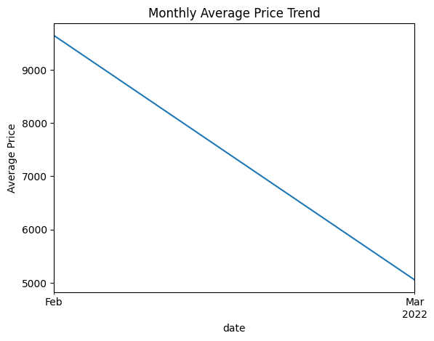
Average Flight Price Trend Analysis
Graph Overview:
Illustrates the average flight prices across February and March 2022.
'Y-axis': Represents average price; 'X-axis': Time split by month.
Key Observations:
Clear Downward Trend: Average prices notably decrease from February to March 2022.
Starting High in February: Prices begin at the peak and consistently decline into March.
Possible Seasonal Influence: Higher prices in February, lower in March, or reflecting demand-supply dynamics.
Significant Price Drop: Steep trend line indicates a substantial one-month price reduction.
Potential Influencing Factors: Market promotions, increased competition, or other dynamic market effects impacting prices.
These insights from the graph highlight a noticeable price trend shift from February to March, potentially influenced by seasonal variations or market dynamics.
This slide encapsulates the main observations from the average flight price trend graph, enabling a clear understanding of the price trend's dynamics within the given timeframe.

Slide 9
Model Training and Evaluation in Flight Price Prediction
Data Preparation and Model Training and Evaluation:
Applied label encoding to convert categorical features into a machine-readable format.
Merged encoded categorical data with numerical features to prepare for modeling.
Split the dataset into 80% training and 20% test sets for model evaluation.
Utilized Linear Regression to predict flight prices based on the features.
Model Performance:
Key Result: Linear Regression resulted in an MSE of 12,235,516.835.
Indicates the average squared difference between actual and predicted prices.
Conclusion and Future Steps:
Interpretation: High MSE suggests potential limitations in capturing data complexity.
Considerations: Explore complex models, feature selection, and hyperparameter tuning for improvement.
Visual Aid:
Linear Regression MSE: 12235516.83501142

Slide 10
Decision Tree Regressor for Flight Price Prediction
Model Implementation:
Employed a Decision Tree Regressor as an alternative to Linear Regression for price prediction.
Baseline Performance:
Trained the model on the training set without parameter tuning, establishing a baseline performance.
Key Result:
Decision Tree Regressor achieved an MSE of 8,311,023.89, surpassing the Linear Regression's MSE.
Conclusion:
Lower MSE indicates improved performance, suggesting better capture of flight price patterns.
Decision Trees offer enhanced flexibility in capturing complex feature-target relationships.
This slide summarizes the adoption of Decision Tree Regression, its performance compared to Linear Regression, and the implications of this analysis in a concise format for your presentation.
Implemented a Decision Tree Regressor to predict flight prices, an alternative to the previous Linear Regression model.
Trained the model on the training set without any prior parameter tuning to establish a baseline performance.
Utilized the test set to make predictions and assess the model's accuracy.
Key Result:
The Decision Tree Regressor yielded an MSE of 8,311,023.885919237, a marked improvement over the Linear Regression model's MSE.
Conclusion:
The lower MSE indicates a better fit to the data, suggesting that the non-linear model captures the patterns in flight pricing more effectively than the linear model.
Decision Trees provide a more flexible approach that can handle complex relationships between features and the target variable

Slide 11
Random Forest Regressor for Enhanced Flight Price Prediction
Model Introduction
Implemented a Random Forest Regressor to predict flight prices using ensemble learning.
Configured the model with default settings and a consistent random state for reproducibility.
Model Training and Evaluation
Utilized the training set to train the model through multiple decision trees.
Deployed the trained model on the test set to assess predictive performance.
Evaluated using Mean Squared Error (MSE) to measure the average difference between actual and predicted prices.
Model Performance
Achieved an MSE of 8,165,147.77 with the Random Forest Regressor.
Indicates relatively good model performance compared to previous methods.
Conclusion
Lower MSE suggests improved effectiveness in capturing dataset complexity.
Random Forest's ensemble approach provides robust predictions with reduced variance.
This deployment of Random Forest Regression enhances predictive accuracy, capturing intricate patterns in flight prices more effectively than prior models.

Slide 12
Logistic Regression for Flight Price Classification
Transformed the regression problem into a binary classification task by defining a price threshold to label flights as 'expensive' or 'cheap.'
Created a new binary target variable is_expensive based on the median price threshold.
Preprocessed the dataset by converting categorical variables to numeric using label encoding.
Split the dataset into training and test sets with an 80-20 split, maintaining reproducibility with a fixed random state.
Logistic Regression Implementation:
Employed Logistic Regression for the binary classification of flights.
Configured the model with a sufficient number of iterations to ensure convergence.
Model Evaluation:
Evaluated the model's performance using accuracy as the metric, which reflects the proportion of correct predictions.
Obtained an accuracy score of 64.34%, demonstrating the model's ability to classify flights as 'expensive' or 'cheap' with moderate reliability.
Conclusion:
The result indicates that logistic regression can provide a baseline for classification accuracy in the context of flight price prediction.
The moderate accuracy suggests there is room for model improvement, possibly through feature engineering, hyperparameter tuning, or trying different classification algorithms.

Slide 13

CONCLUSION
• The application of Linear Regression indicated a high MSE, suggesting a potential misalignment between model predictions and actual prices, which could be due to model simplicity or data complexity.
• Decision Tree Regressor demonstrated a lower MSE than Linear Regression, highlighting its capacity to model non-linear relationships in the data more effectively.
• Random Forest Regressor, an ensemble method, further reduced the MSE, outperforming the single Decision Tree, which suggests that ensemble methods are better at capturing the complexities of the dataset.
• The adaptation of Logistic Regression for binary classification based on a defined price threshold yielded a moderate accuracy of 64.34%, showing potential for categorical price prediction but also room for improvement.

